Slide 1
Correlation
(Based on web slides by
James H. Steiger)
NC 812/ESD 812

Slide 2
The Variance and Standard Deviation
The most important measure of variability is based on deviations of individual observations about the central value. For this purpose the mean usually serves as the center.

Slide 3
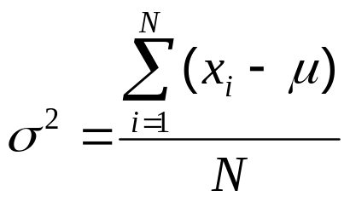


MEASURES OF VARIABILITY
POPULATION VARIANCE
The population variance is the mean squared deviation from the population mean:
Where σ² stands for the population variance
μ is the population mean
N is the total number of values in the population
is the value of the i-th observation.
represents a summation

Slide 4
Covariance
Variables may change in relation to each other
Covariance measures how much the movement in one variable predicts the movement in a corresponding variable

Slide 5
Smoking and Lung Capacity
Example: investigate relationship between cigarette smoking and lung capacity
Data: sample group response data on smoking habits, and measured lung capacities, respectively

Slide 6
Smoking v Lung Capacity Data
N | Cigarettes (X ) | Lung Capacity (Y )
1 | 0 | 45
2 | 5 | 42
3 | 10 | 33
4 | 15 | 31
5 | 20 | 29

Slide 7
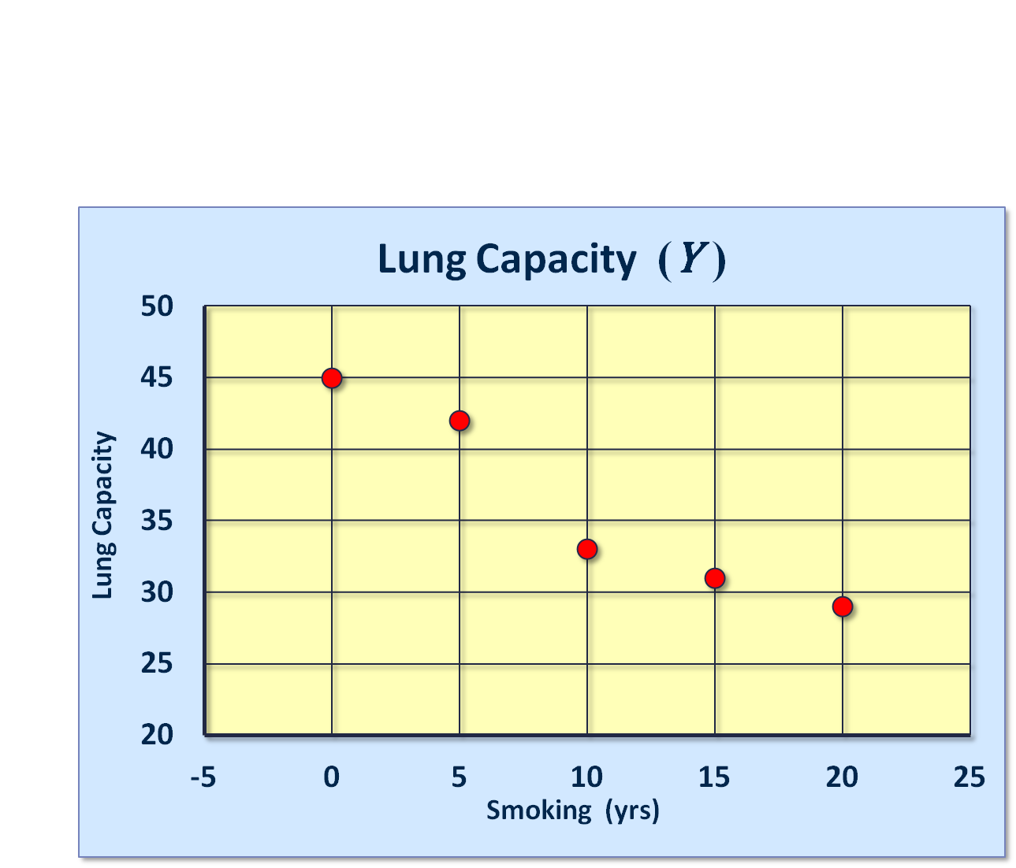
Smoking and Lung Capacity

Slide 8
Smoking v Lung Capacity
Observe that as smoking exposure goes up, corresponding lung capacity goes down
Variables covary inversely
Covariance and Correlation quantify relationship

Slide 9
Covariance
Variables that covary inversely, like smoking and lung capacity, tend to appear on opposite sides of the group means
  When smoking is above its group mean, lung capacity tends to be below its group mean.
Average product of deviation measures extent to which variables covary, the degree of linkage between them

Slide 10
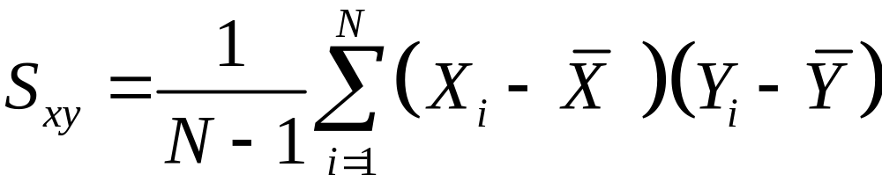
The Sample Covariance
Similar to variance, for theoretical reasons, average is typically computed using (N -1), not N . Thus,

Slide 11


Calculating Covariance
Cigs (X ) | Lung Cap (Y )
0 | 45
5 | 42
10 | 33
15 | 31
20 | 29
10 | 36

Slide 12
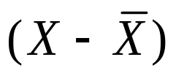
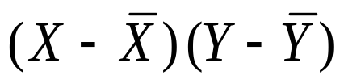
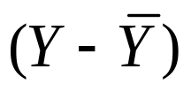
Calculating Covariance
Cigs (X ) |  |  |  | Cap (Y )
0 | -10 | -90 | 9 | 45
5 | -5 | -30 | 6 | 42
10 | 0 | 0 | -3 | 33
15 | 5 | -25 | -5 | 31
20 | 10 | -70 | -7 | 29
 |  | ∑= -215

Slide 13
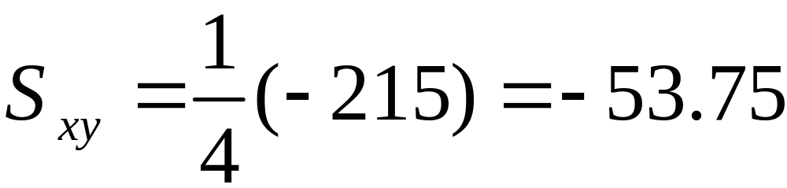
Covariance Calculation
Evaluation yields,

Slide 14
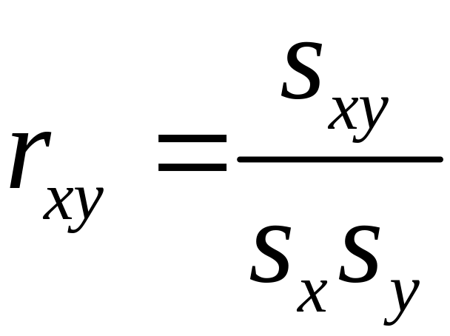
Correlation Coefficient

Slide 15
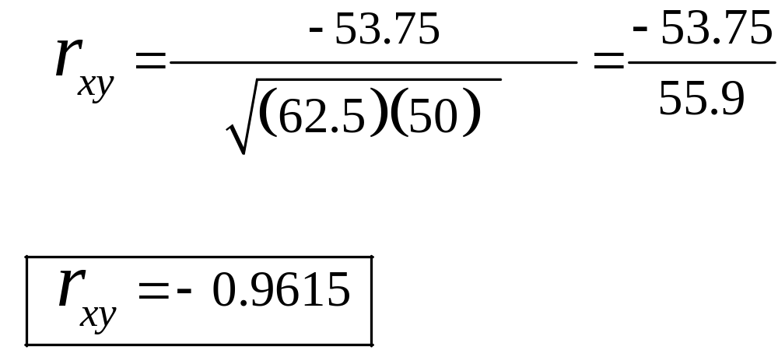
Computing Correlation

Slide 16
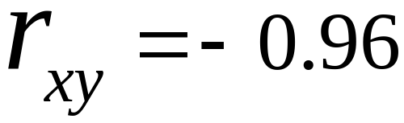
Conclusion
r_{xy} = -0.96 implies almost certainty smoker will have diminish lung capacity
Greater smoking exposure implies greater likelihood of lung damage

Slide 17
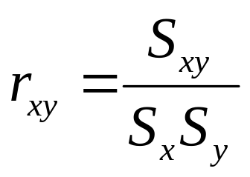
Correlation Coefficient
The correlation coefficient of two variables in a data set equals to their covariance divided by the product of their individual standard deviations. It is a normalized measurement of how the two are linearly related.
Formally, the sample correlation coefficient is defined by the following formula, where s_{x} and s_{y} are the sample standard deviations, and s_{xy} is the sample covariance.

Slide 18
Correlation Coefficient
x = randn(6,1);
y = randn(6,1);
A = [x y 2*y+3];
R = corrcoef(A)
R =
1.0000 -0.6237 -0.6237
-0.6237 1.0000 1.0000
-0.6237 1.0000 1.0000

Slide 19
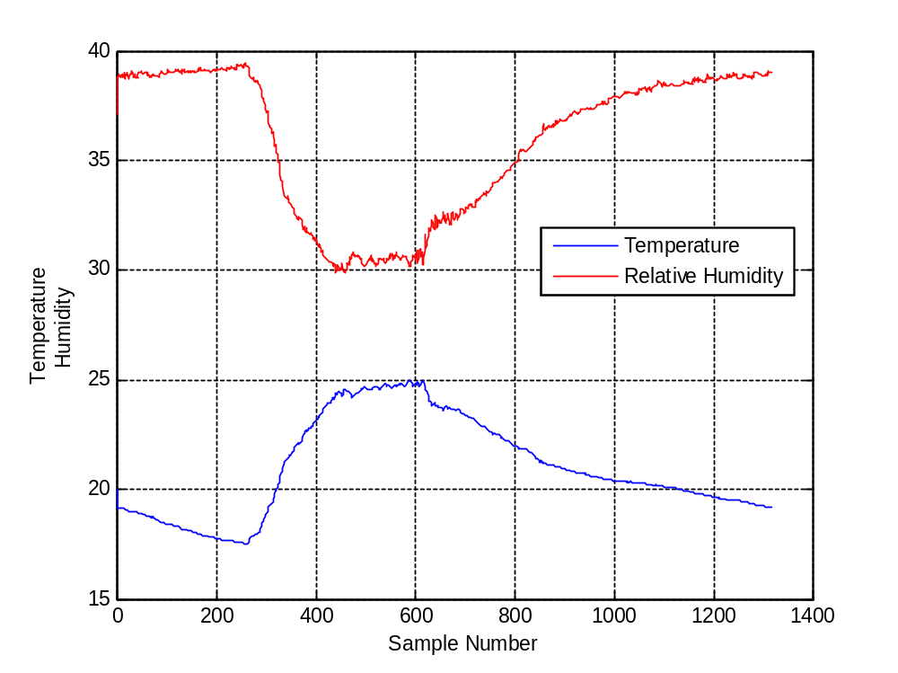
Temperature and Humidity Data

Slide 20
Correlation Coefficient
>> corrcoef(temp_data, humidity1)
ans =
1.0000 -0.9522
-0.9522 1.0000

Slide 21
Correlation
Correlation addresses the question: “to what degree is signal A similar to signal B.”
An intuitive answer can be developed by comparing deterministic signals with stochastic signals.
  Deterministic = a predictable signal equivalent to that produced by a mathematical function
  Stochastic = an unpredictable signal equivalent to that produced by a random process

Slide 22
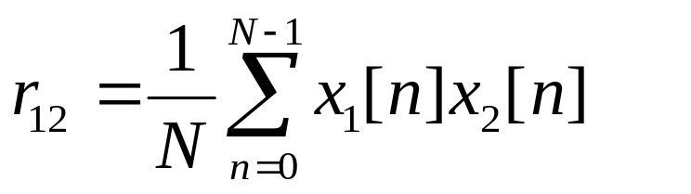
Quantitative Correlation
We seek a quantitative and algorithmic way of assessing correlation
A possibility is to multiple signals sample-by-sample and average the results. This would give a relatively large positive value for identical signals and a near zero value for two random signals.

Slide 23
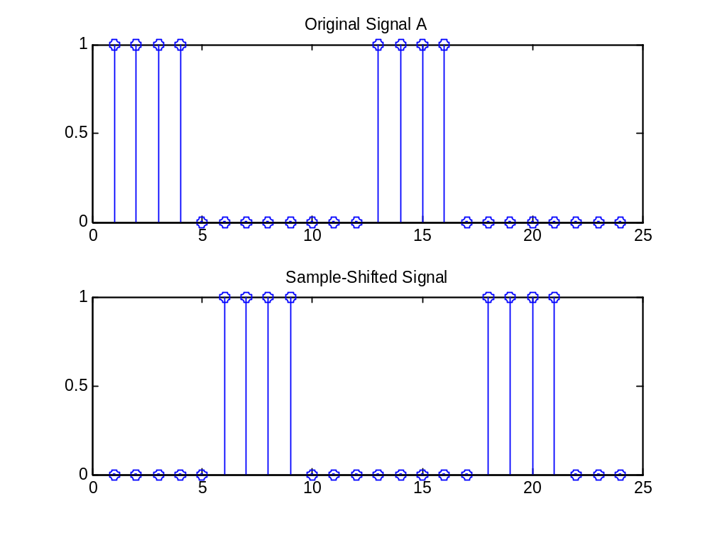
Simple Cross-Correlation
In this case, the simple cross-correlation would be zero despite the fact the two signals are obviously “correlated.”

Slide 24
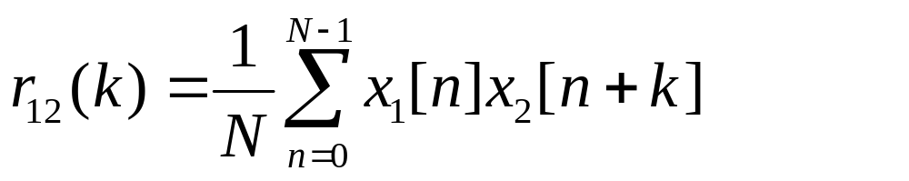
Sample-Shifted Cross-Correlation
Shift the signals k steps with respect to one another and calculate r₁₂(k).
All possible k shifts would produce a vector of values, the “full” cross-correlation.

Slide 25
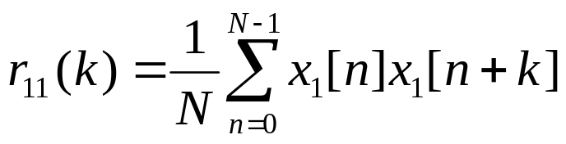
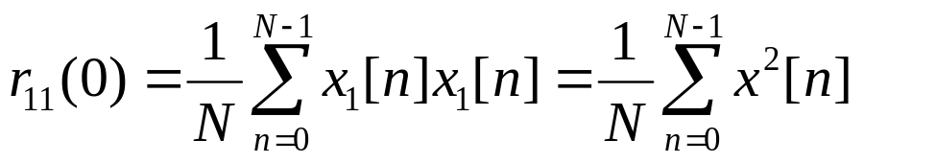
Auto-Correlation
The cross-correlation of a signal with itself is called the auto-correlation
The “zero-lag” auto-correlation is the same as the mean-square signal power.

Slide 26
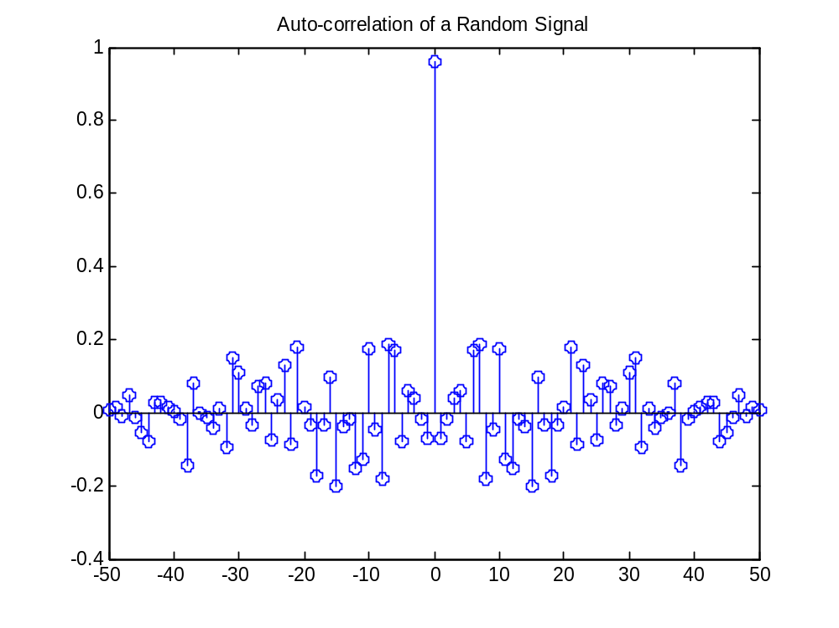
Auto-Correlation of a Random Signal
Mathematically, the auto-correlation of a random signal is like the impulse function

Slide 27
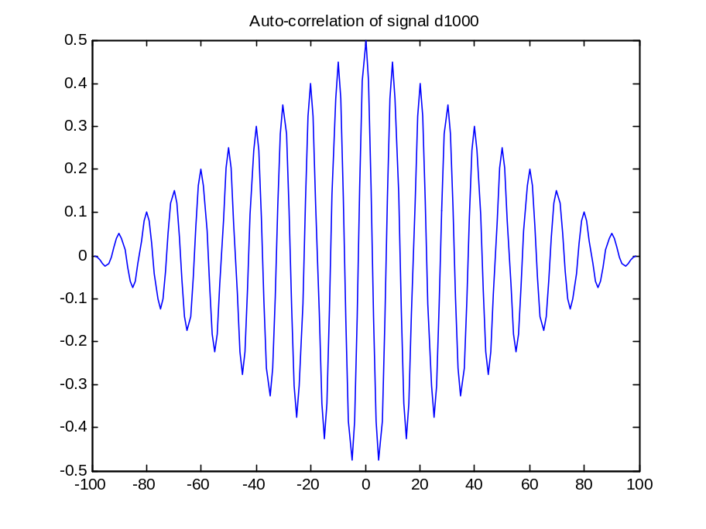
Auto-Correlation of a Sinusoid
The auto-correlation vector has the same frequency components as the original signal

Slide 28
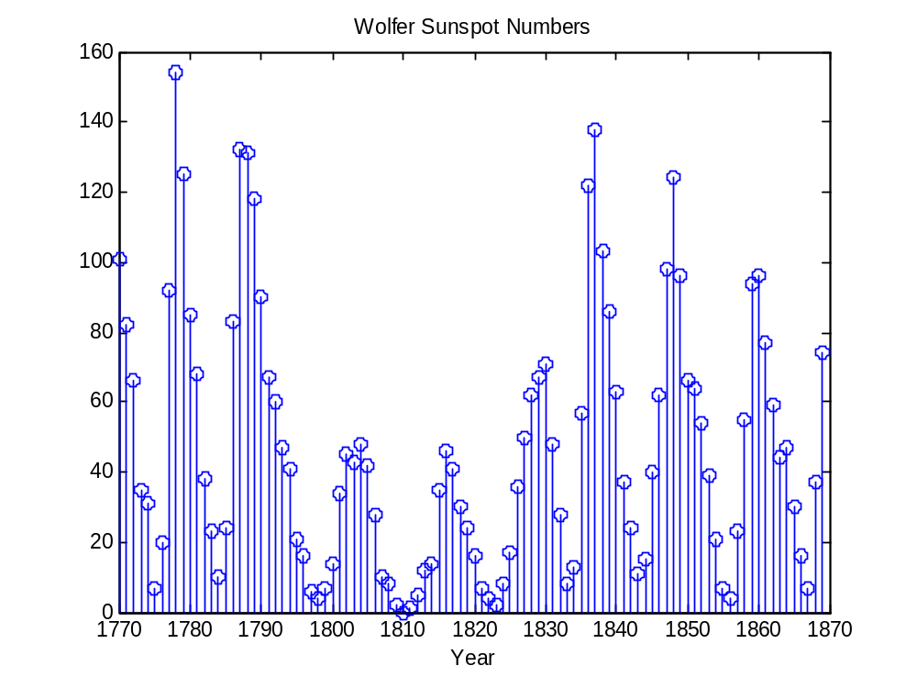
Detecting Periodicities in Noisy Data: Annual Sunspot Data

Slide 29
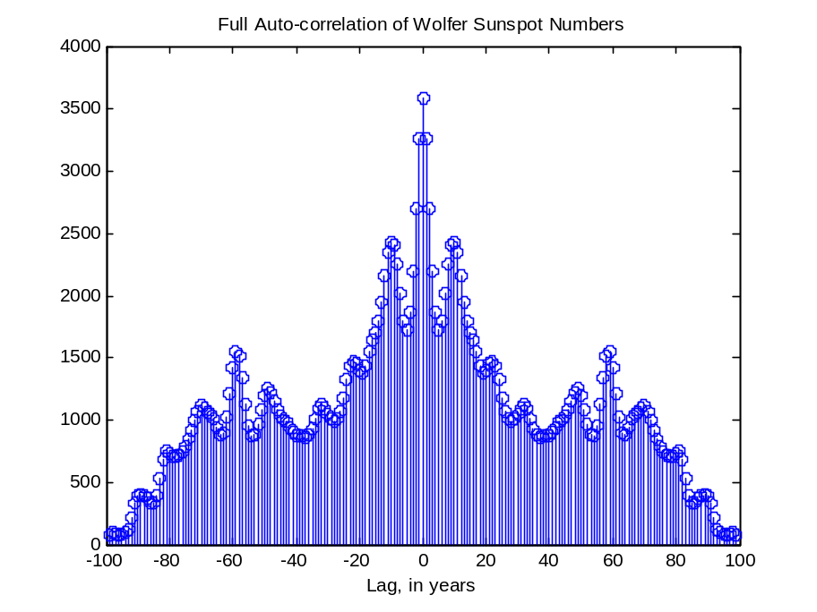
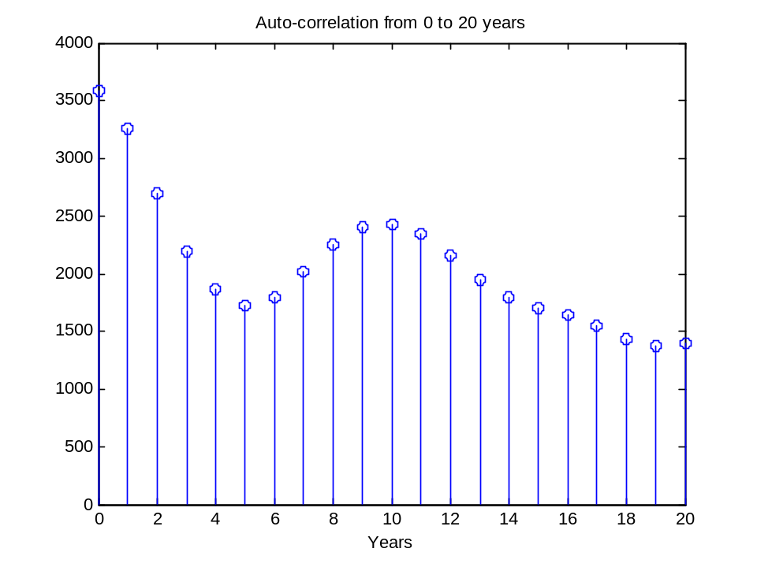
Detecting Periodicities in Noisy Data: Annual Sunspot Data
Autocorrelation has detected a periodicity of 9 to 11 years

Slide 30


Correlation of Discrete-Time Signals
Transmitted Signal, x(n)
Reflected Signal,
y(n) = x(n-D) + w(n)
0
T

